Slide 1

Fundamentals of Information Science:
Part 3: Coding Technologies
Shandong University
2025 Spring

Slide 2
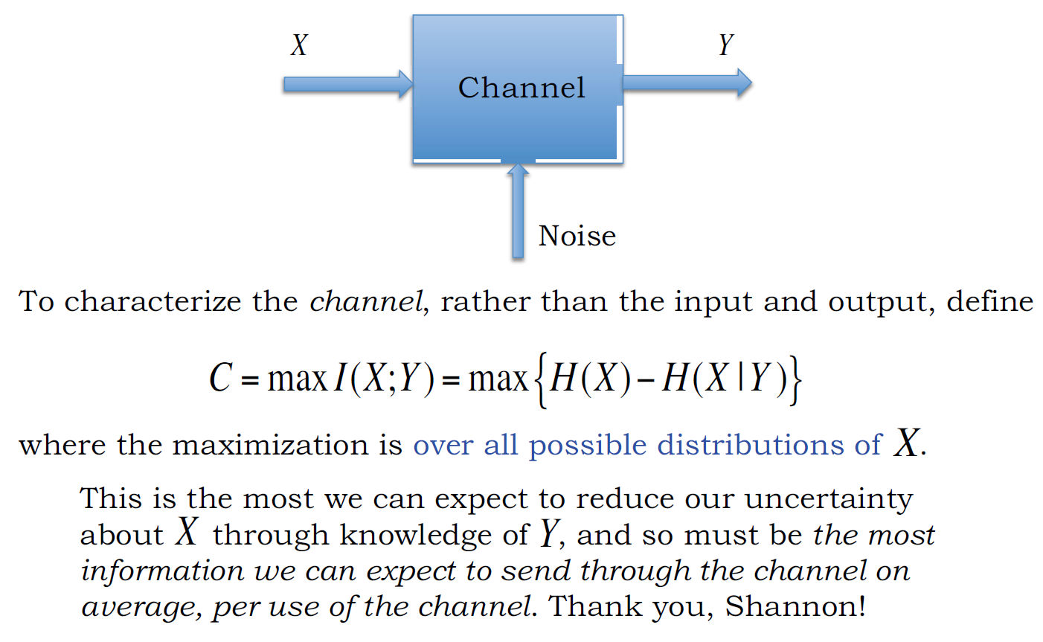
Channel Capacity

Slide 3
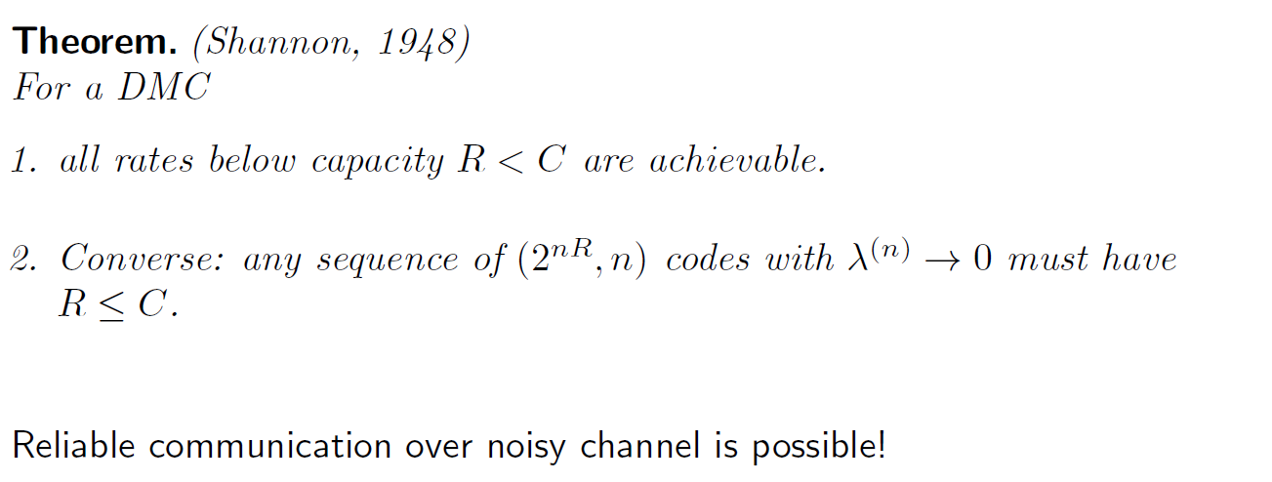
Channel Coding Theorem

Slide 4
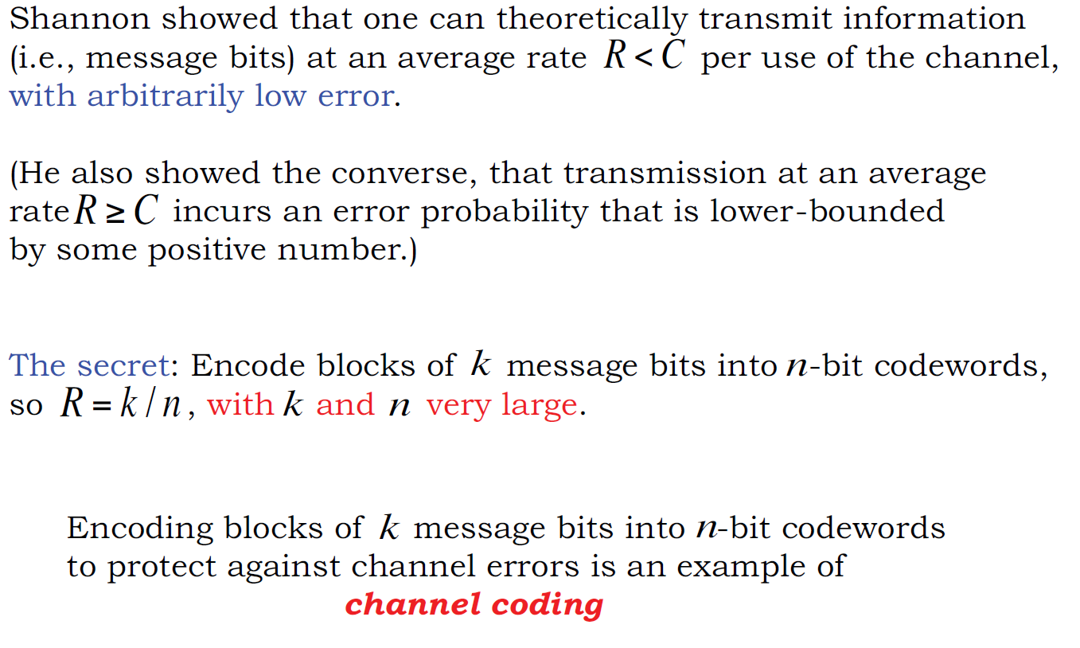
Asymptotically Error-free at R < C

Slide 5
Lecture 2.2 : Linear Block Codes

Slide 6
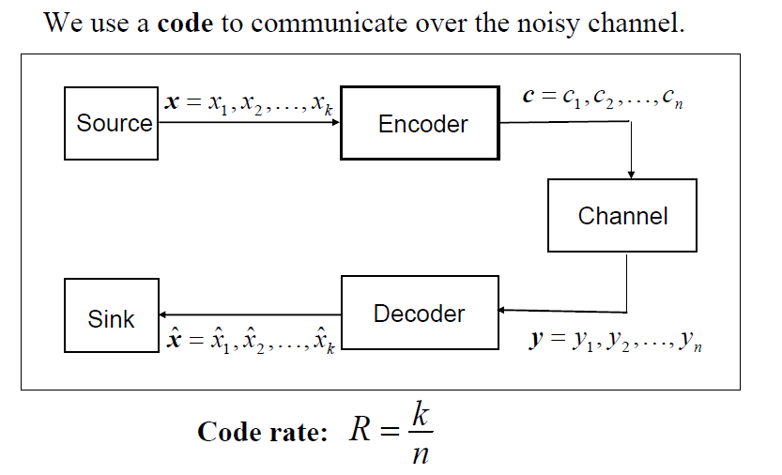
Channel Coding

Slide 7
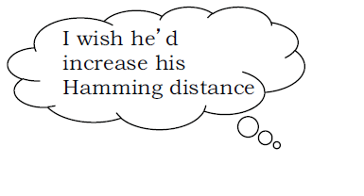
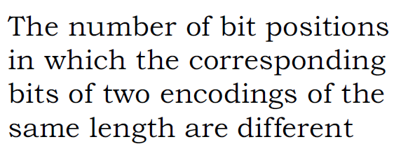
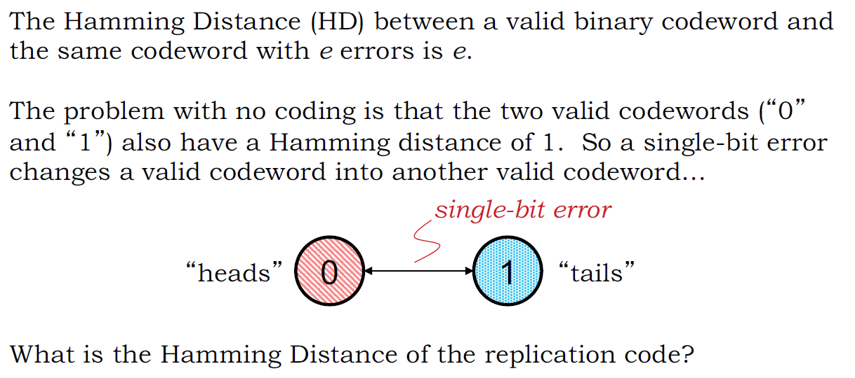
Hamming Distance

Slide 8
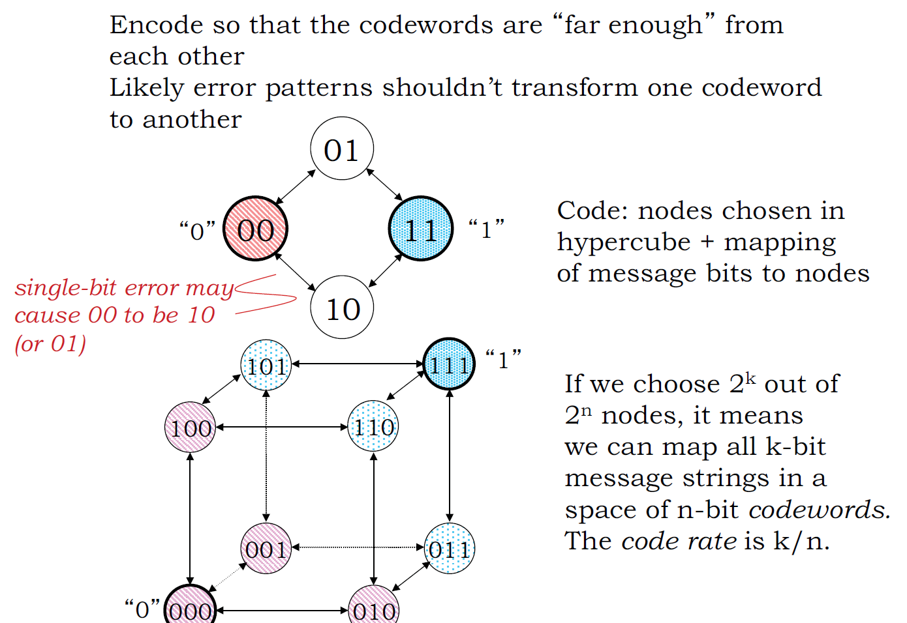
Idea： Embedding for Structural Separation

Slide 9
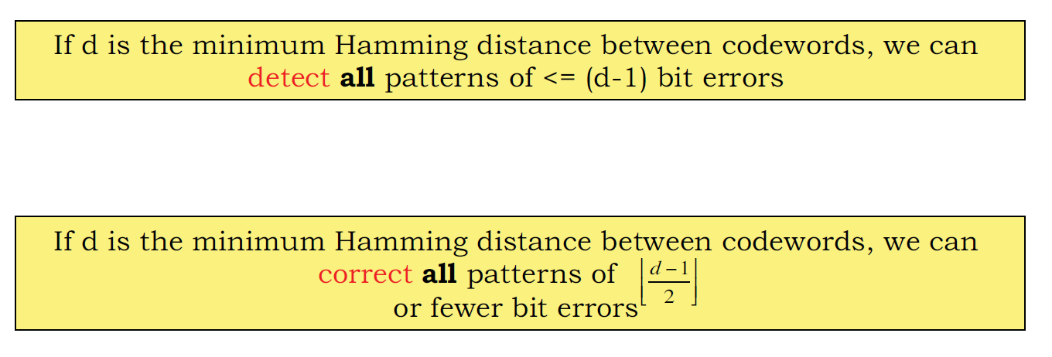
Minimum Hamming Distance of Codes vs. Detection & Correction Capabilities

Slide 10
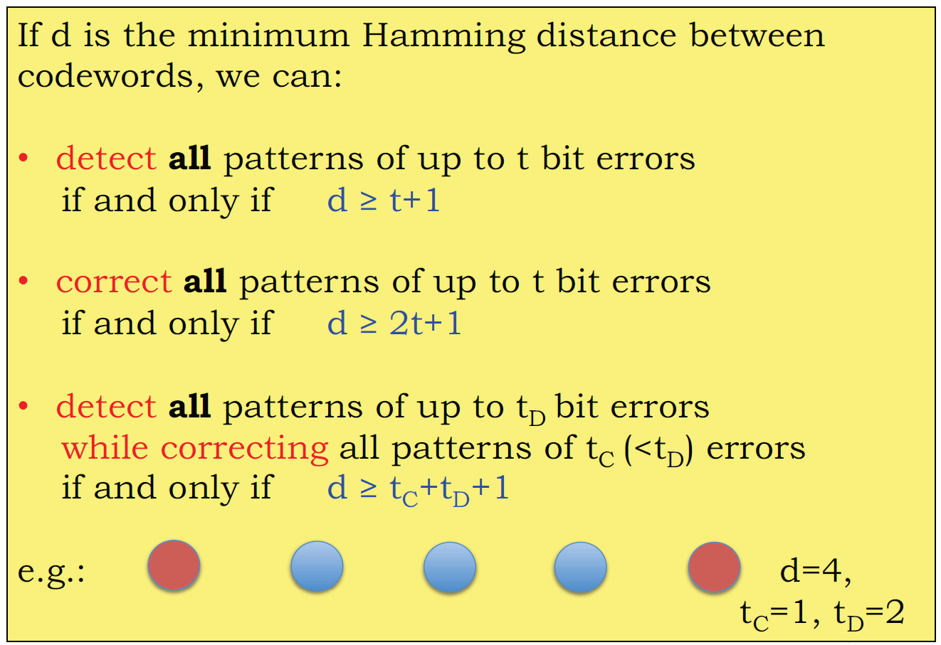
Minimum Hamming Distance

Slide 11
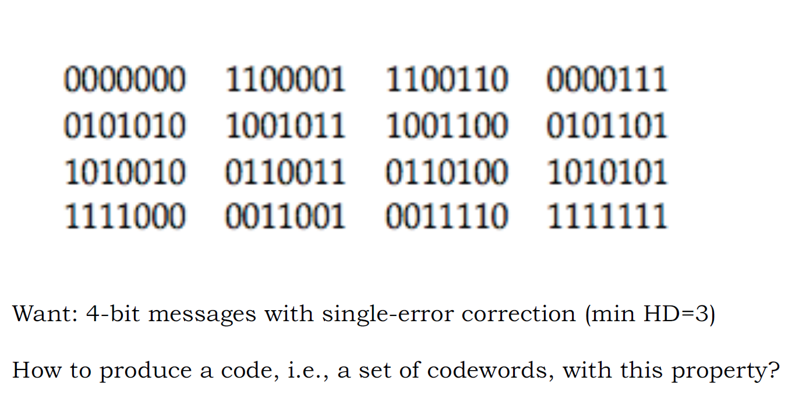
How to Construct Codes

Slide 12
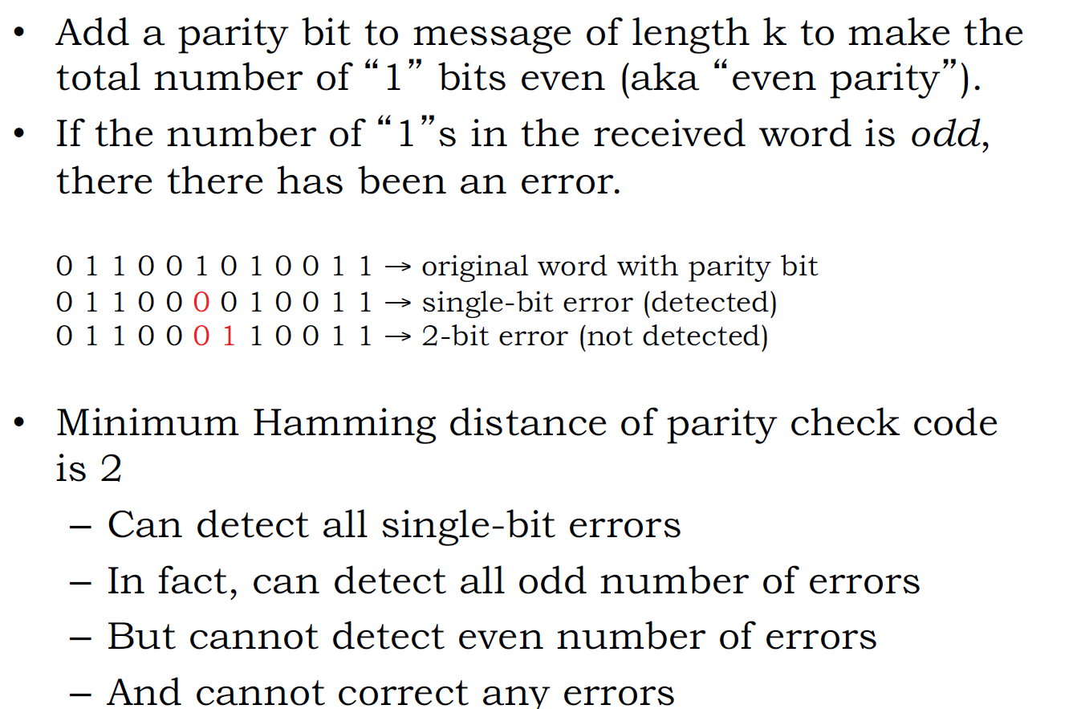
A Simple Code: Parity Check

Slide 13
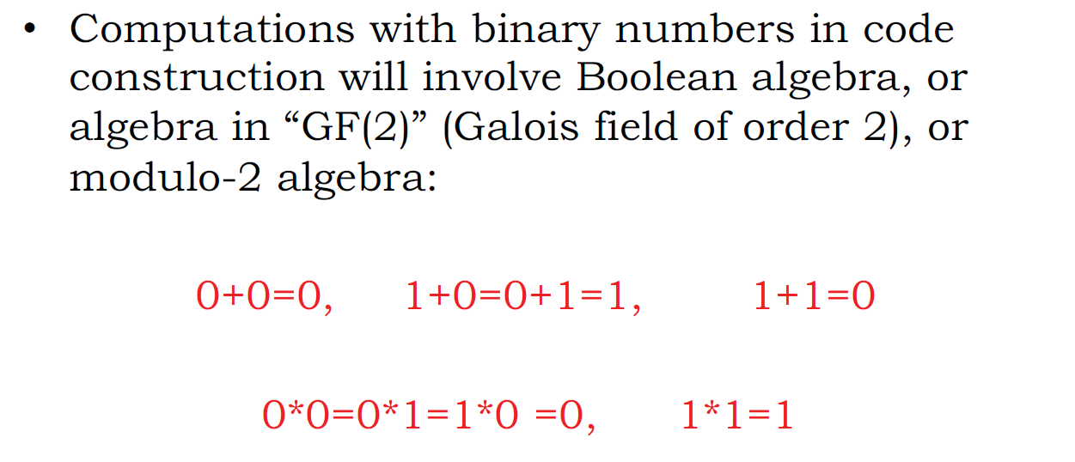
Binary Arithmetic

Slide 14
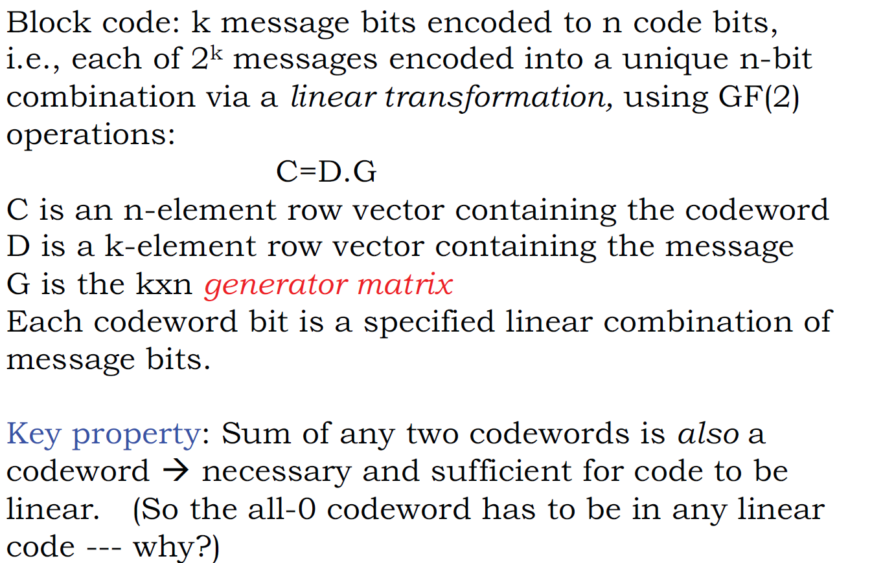
Linear Block Codes

Slide 15
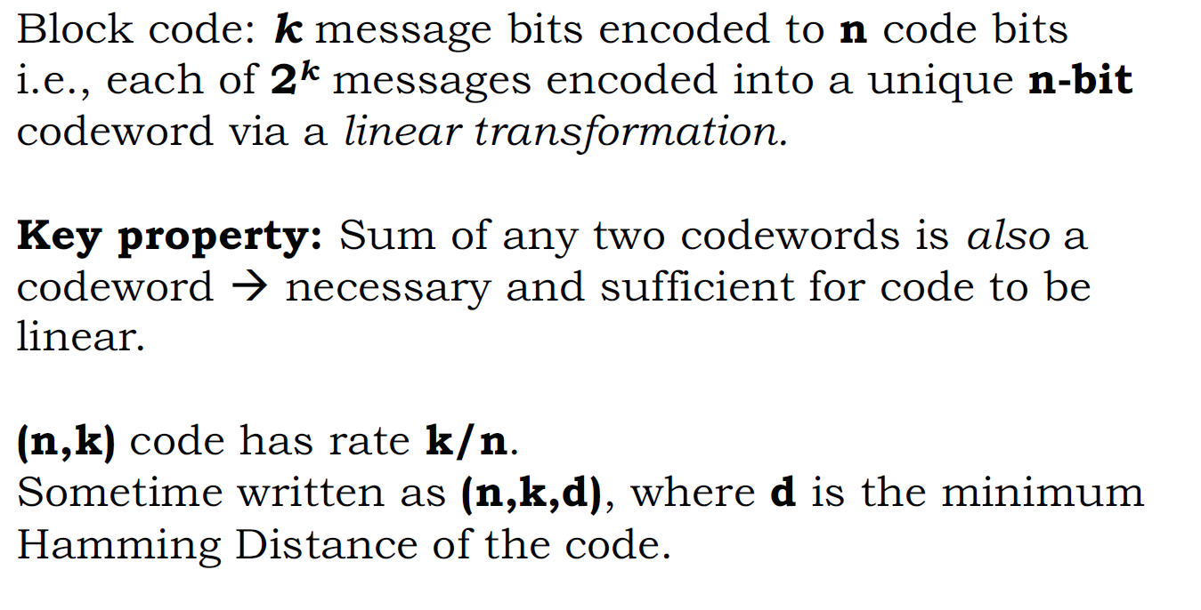
Linear Block Codes

Slide 16
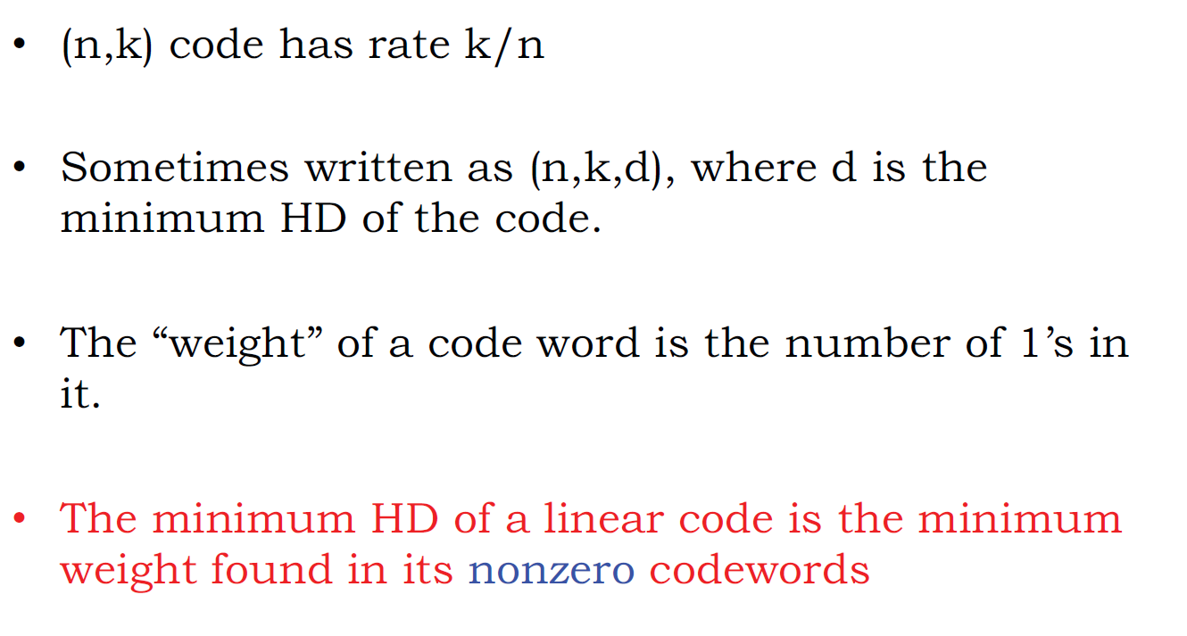
Minimum HD of Linear Code

Slide 17
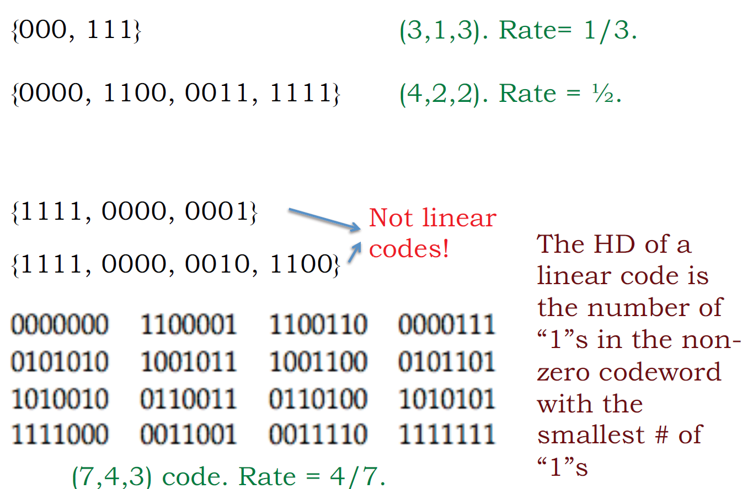
Examples: What are n, k, d here?

Slide 18
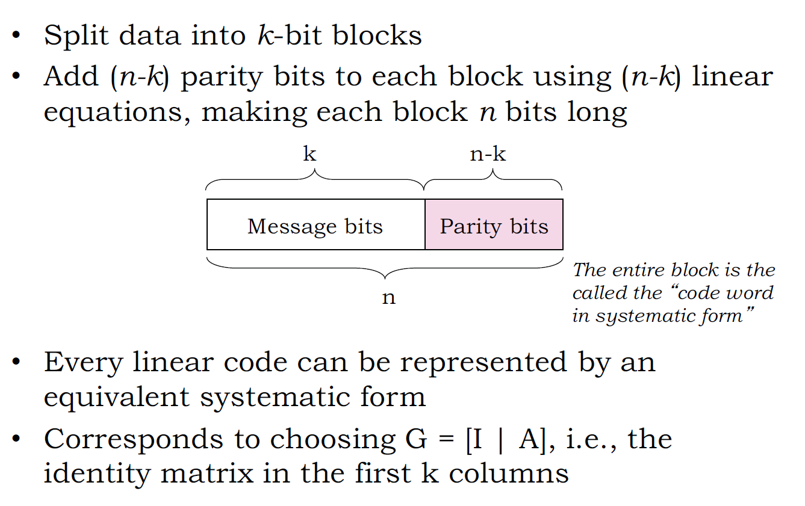
(n, k) Systematic Linear Block Codes

Slide 19
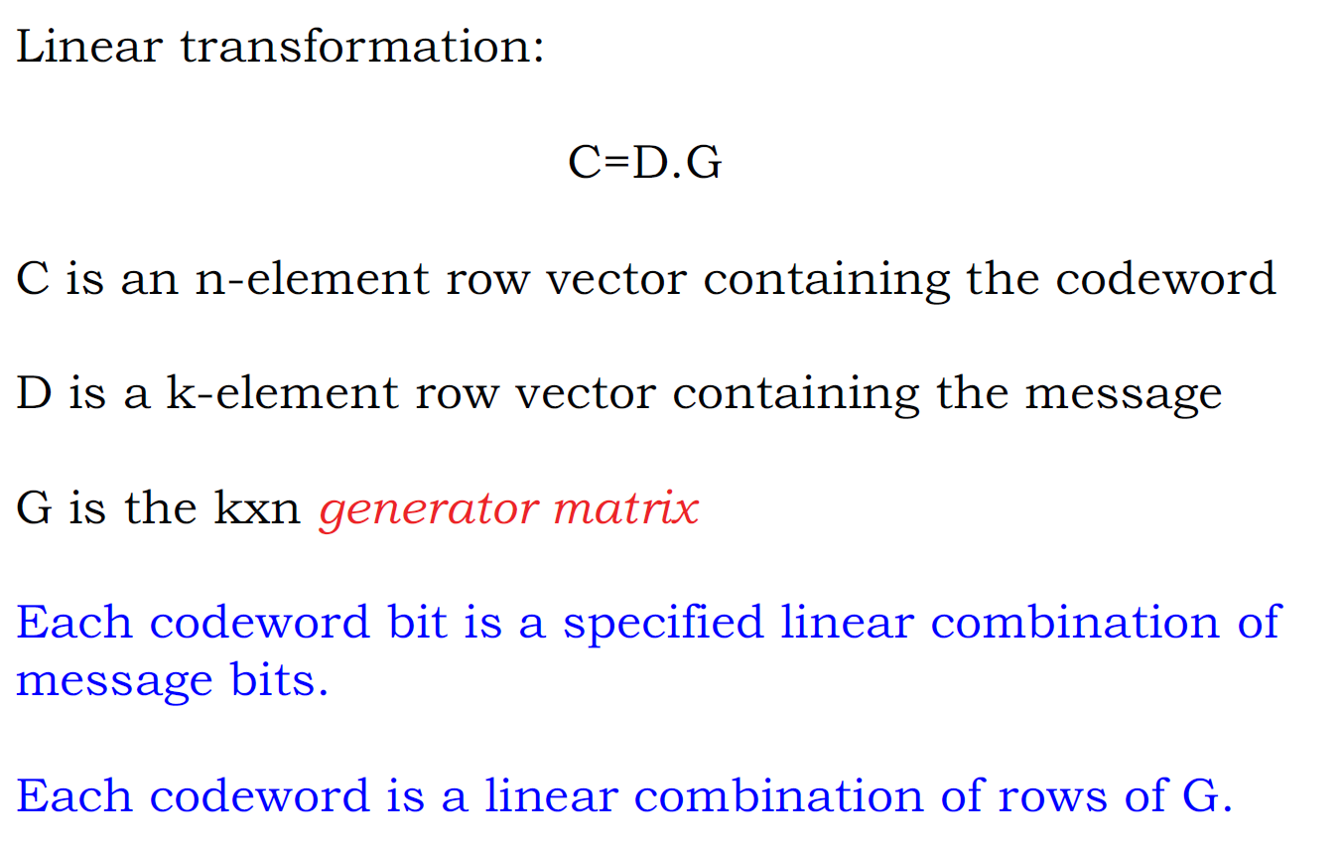
Generator Matrix of Linear Block Code

Slide 20
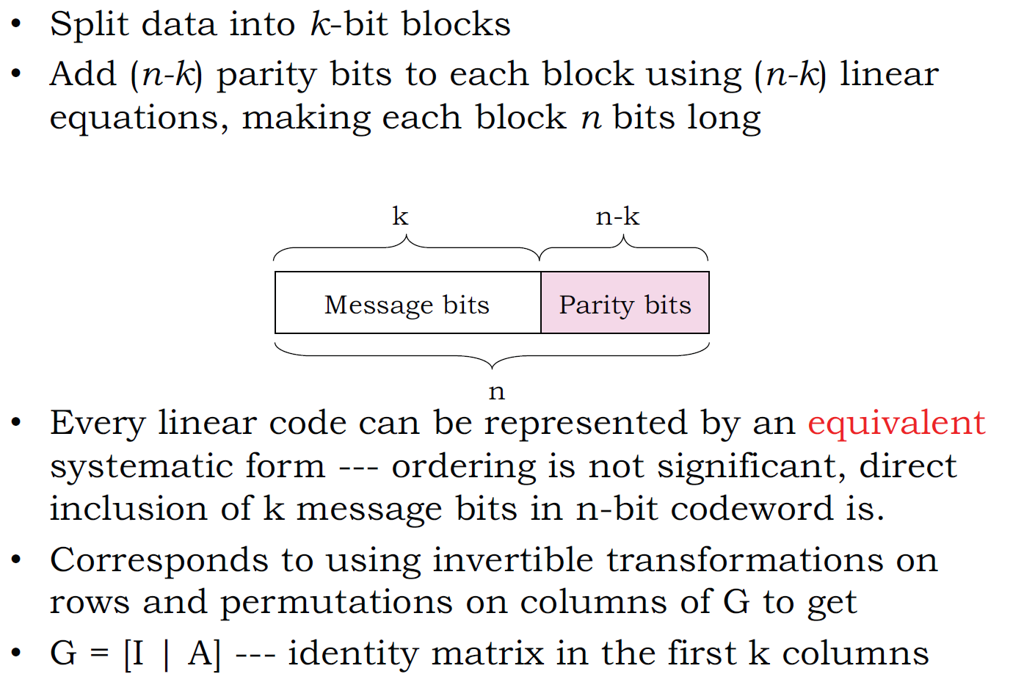
(n, k) Systematic Linear Block Codes

Slide 21
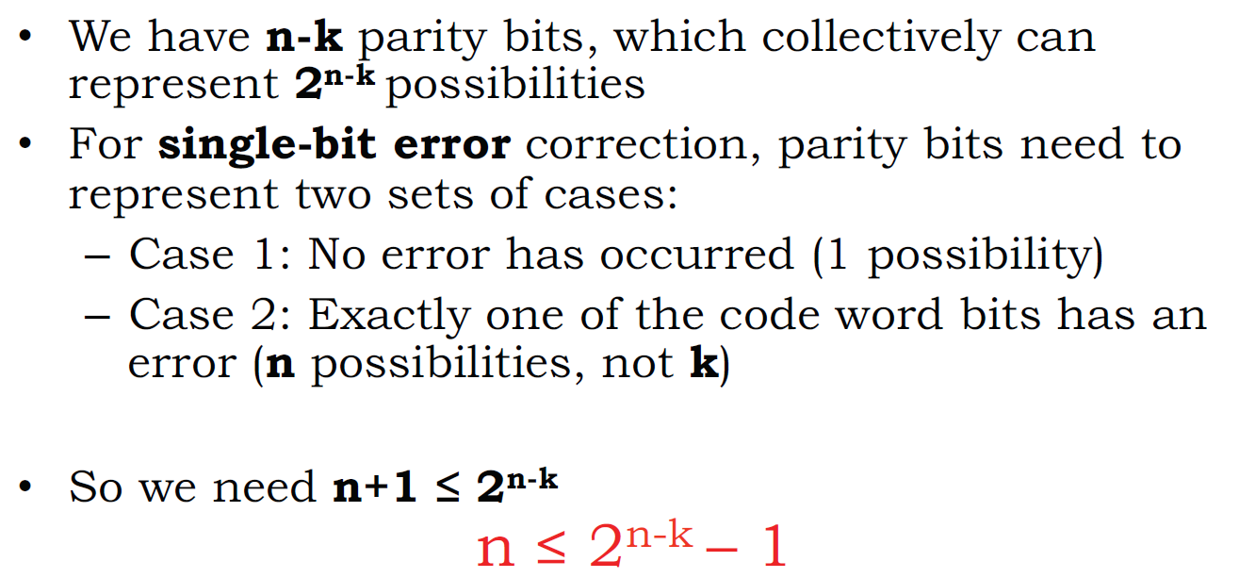
How Many Parity Bits Do We Need?

Slide 22
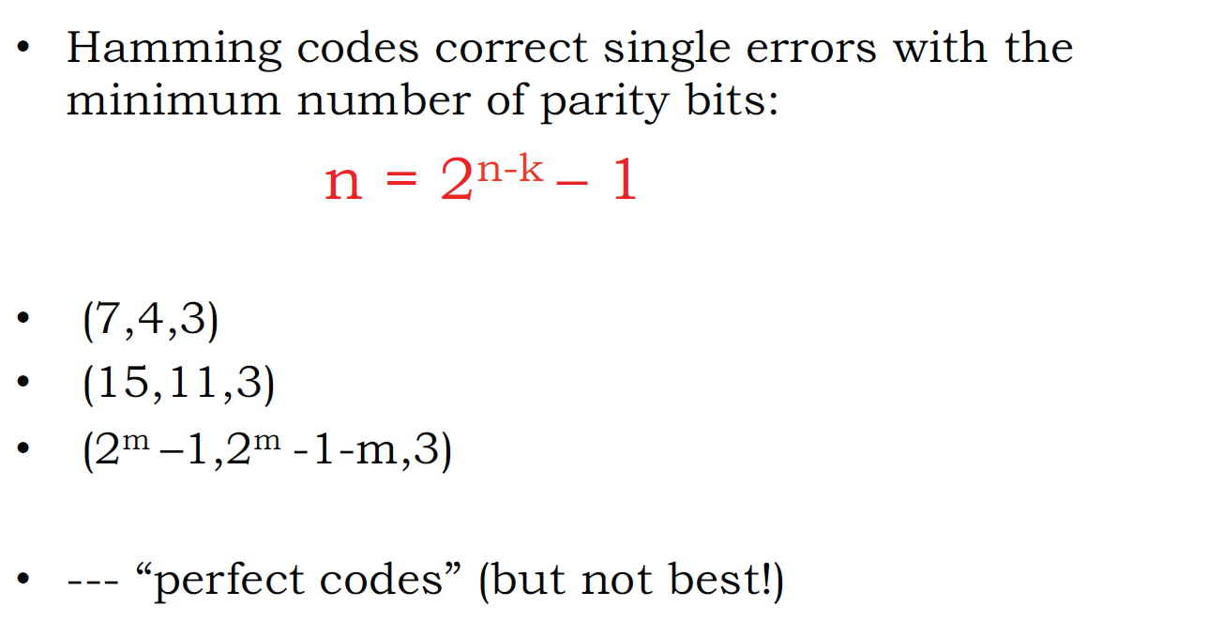
Hamming Codes

Slide 23
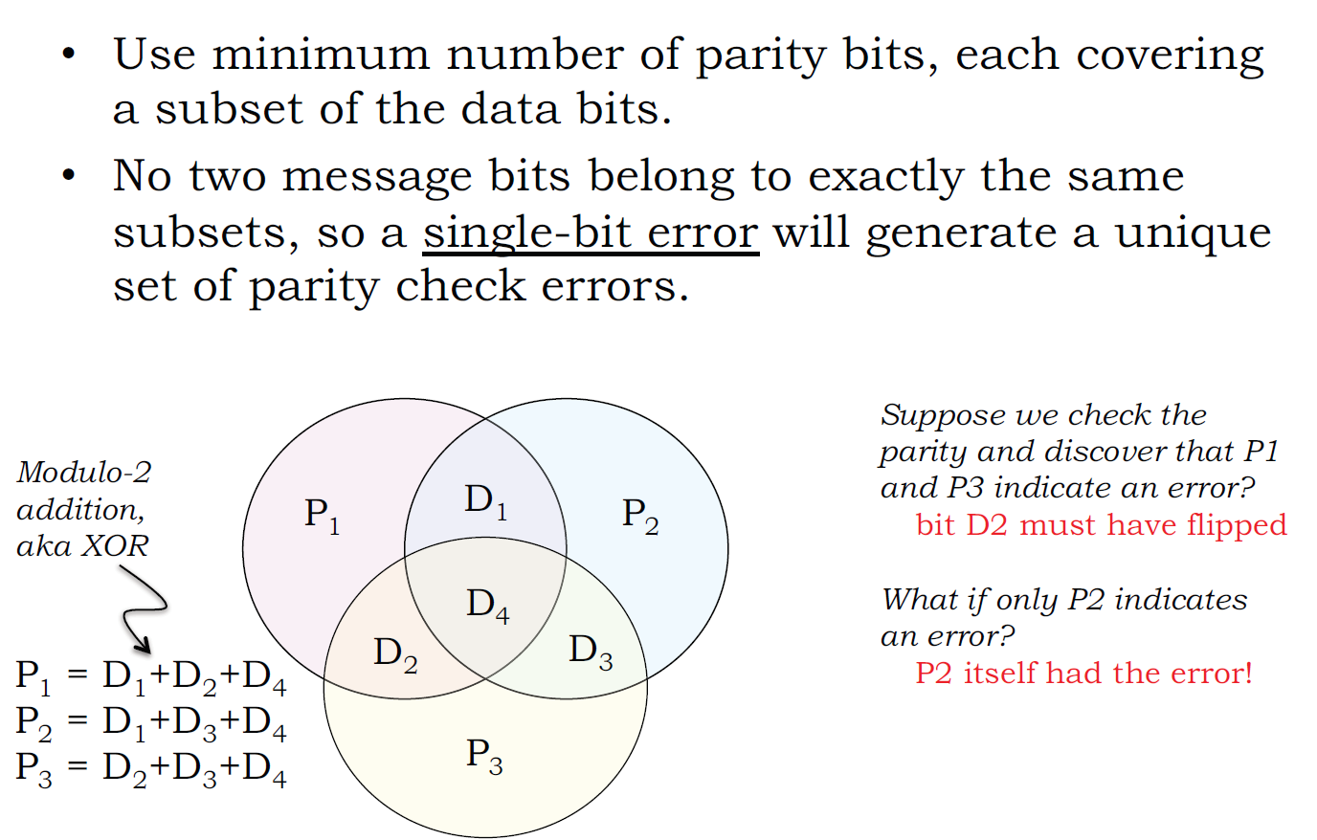
(7, 4, 3) Hamming Code

Slide 24
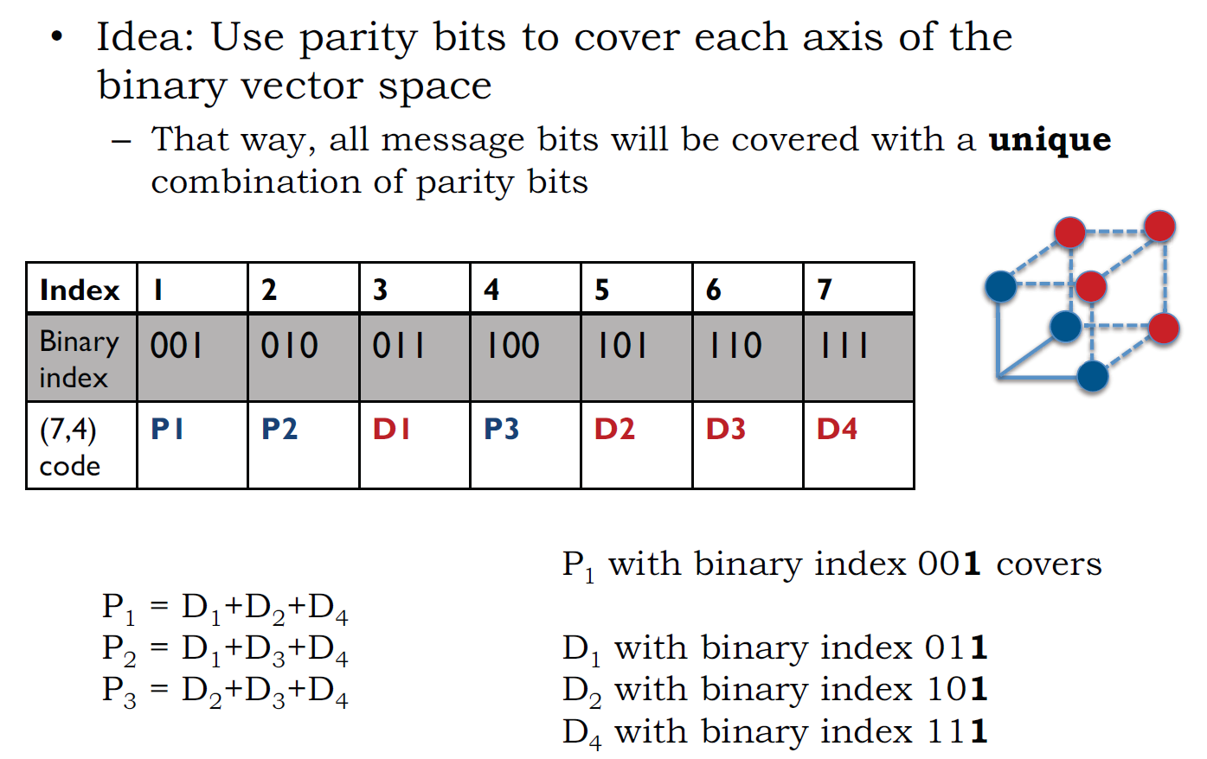
Logic Behind Hamming Code

Slide 25
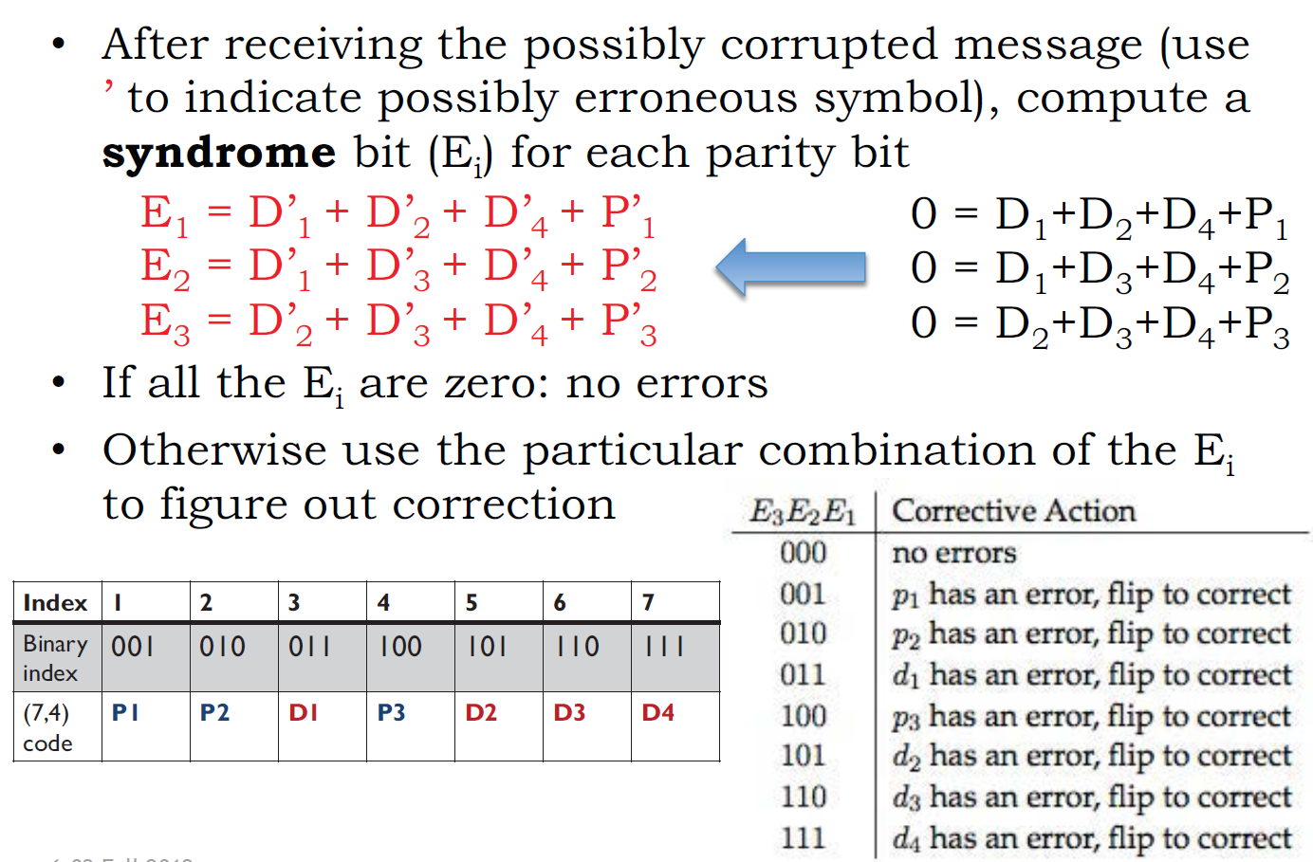
Syndrome Decoding: Idea

Slide 26
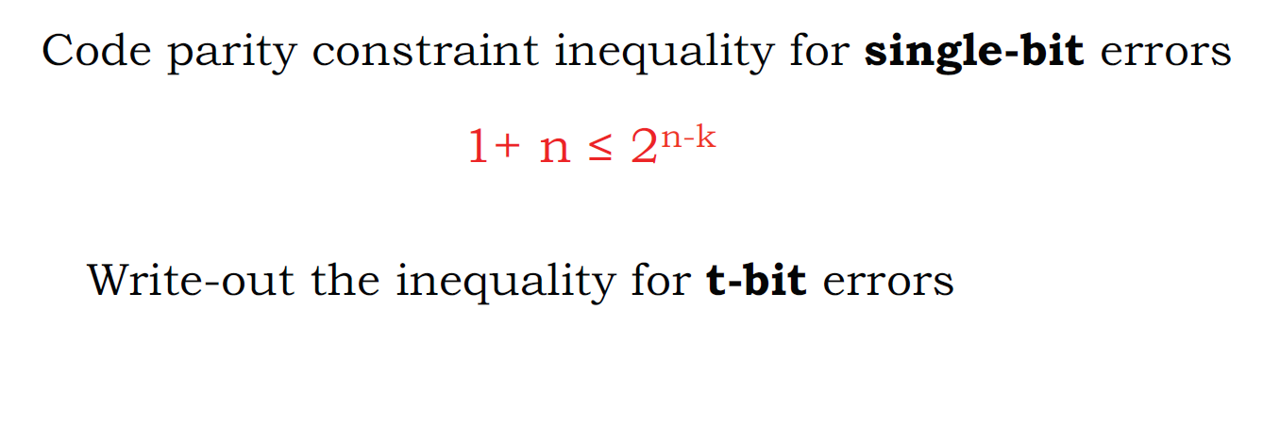
Constraints for more than single-bit errors

Slide 27
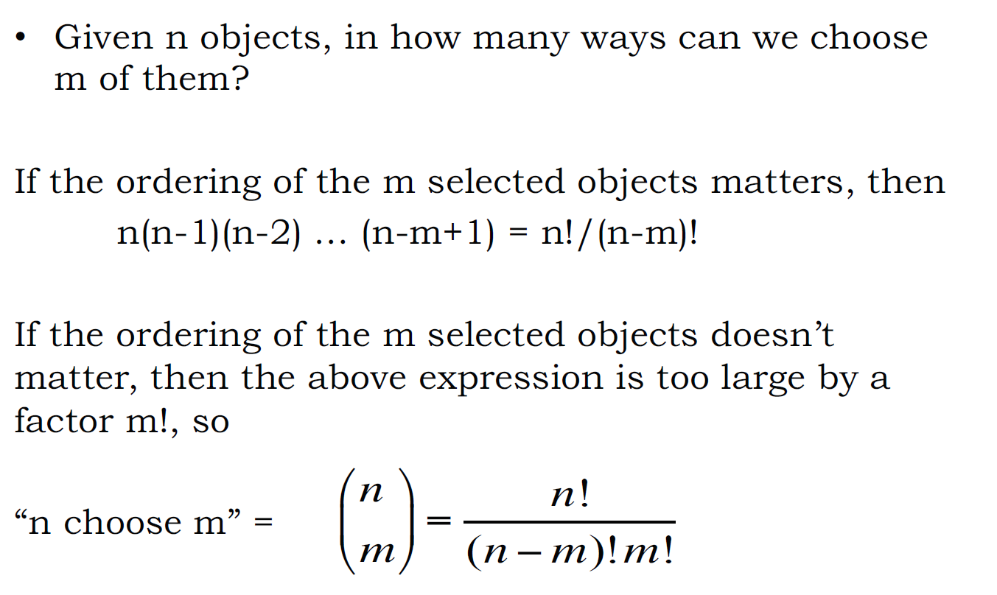
Elementary Combinatorics

Slide 28
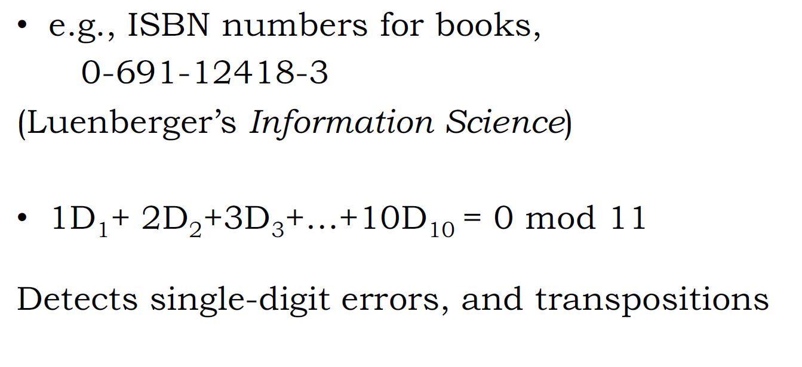
Error-Correcting Codes occur in many other contexts

Slide 29
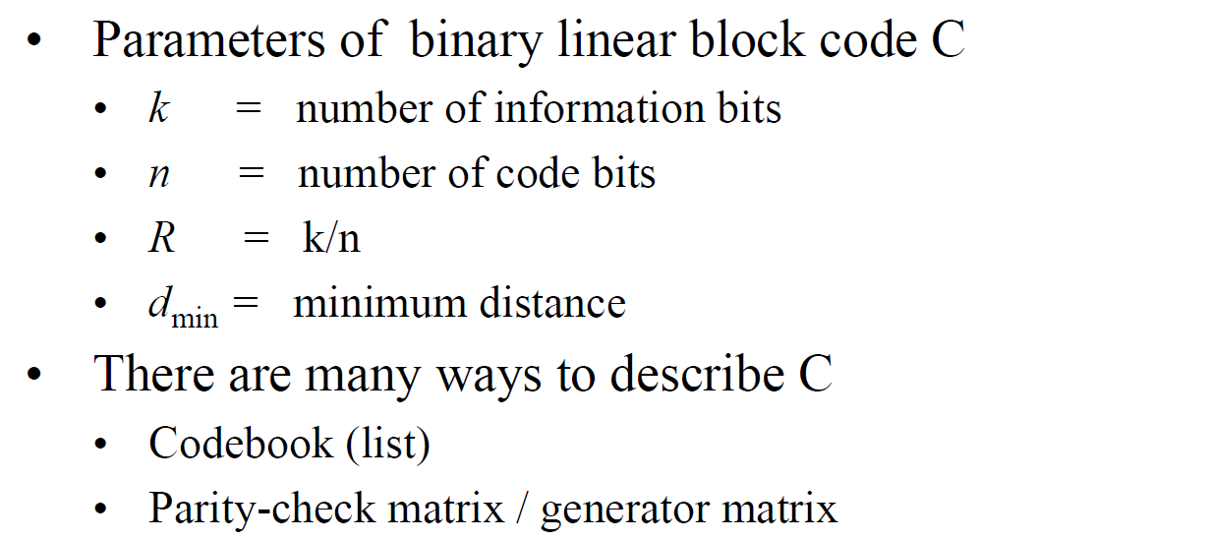
Linear Block codes - Basis

Slide 30
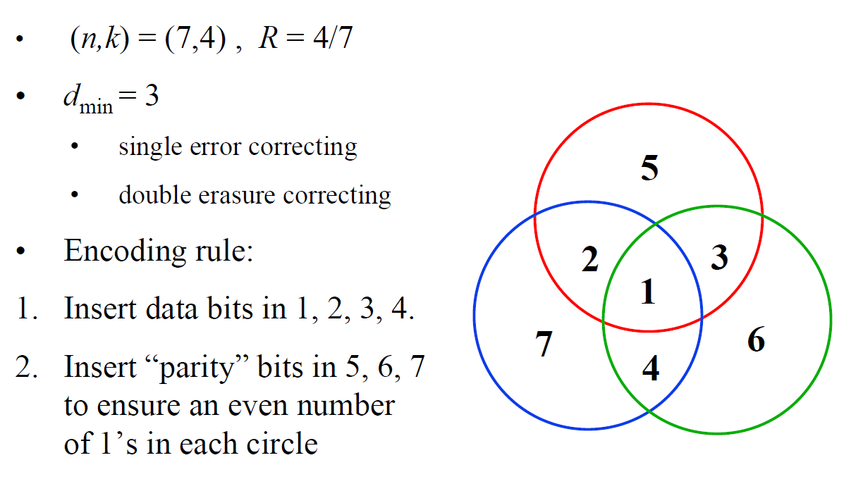
Example: (7, 4) Hamming Code

Slide 31
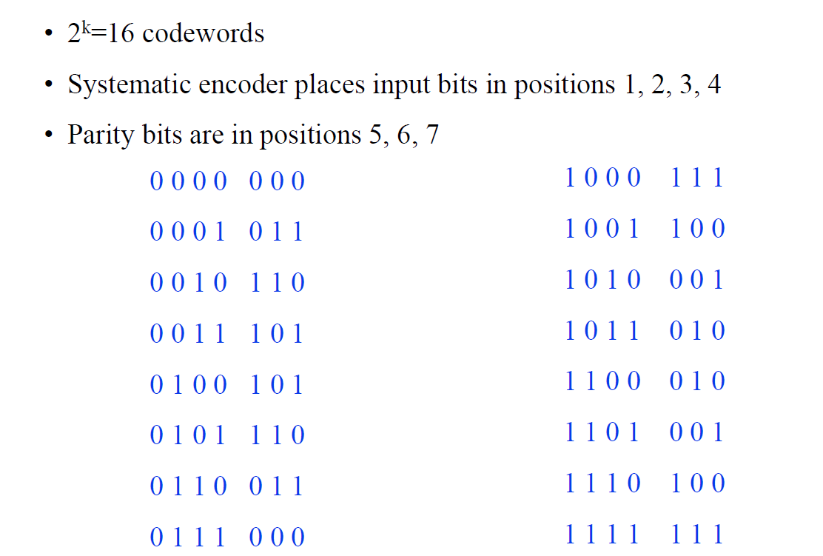
Example: (7, 4) Hamming Code

Slide 32
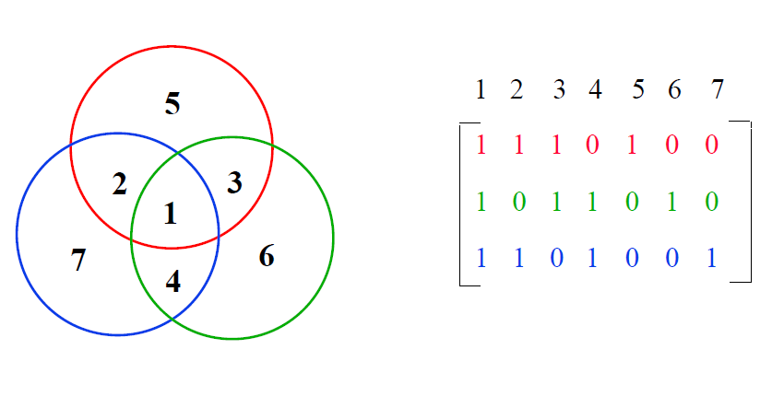
Hamming Code – Parity Checks

Slide 33
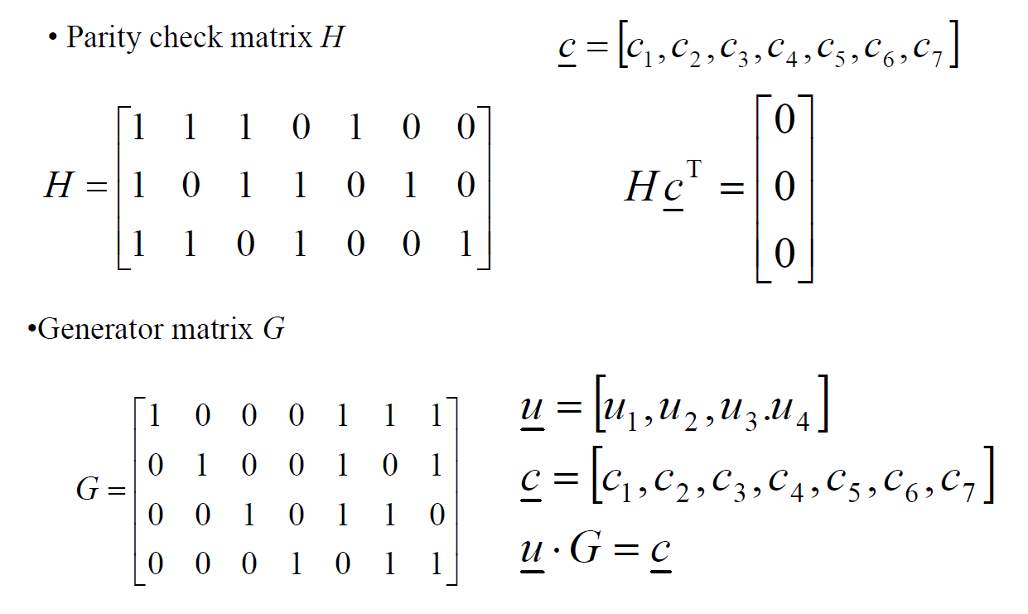
Hamming Code – Matrix Perspective

Slide 34
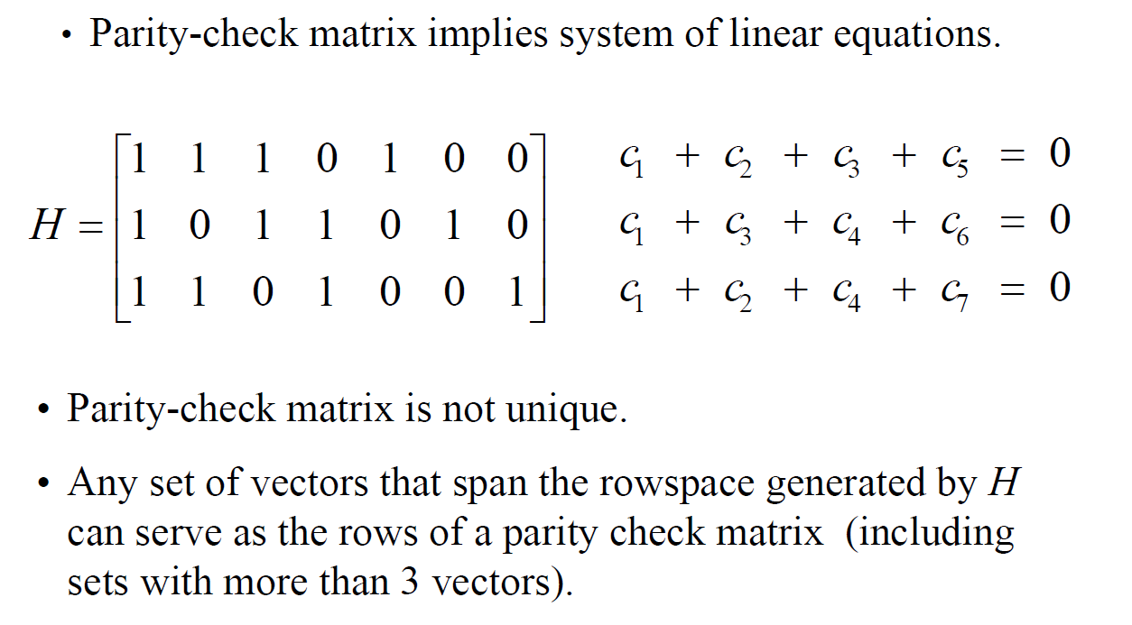
Parity-Check Equations

Slide 35

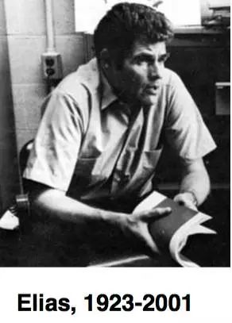



Evolution of Channel Coding
Richard Hamming
(1915-1998)
Peter Elias
(1923-2001)
Irving Reed
（1923-2012)
Andrew J. Viterbi
(1935-)
Claude Berrou
(1951-)
1993
Turbo Code
3G/4G
1948
Hamming Code
1955
Convolution Code
1960
Reed-Solomon Code
1967
Viterbi Decoding

Slide 36
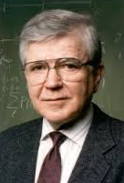

Asymptotically (near) optimal coding (5G)
Robert Gallager
(1931-)
1962年发明LDPC码
埃达尔·阿利坎
Erdal Arikan
(1958-)
2008年发明Polar码

Slide 37
Lecture 2.3 : Reed-Solomon Codes, BCH Codes

Slide 38
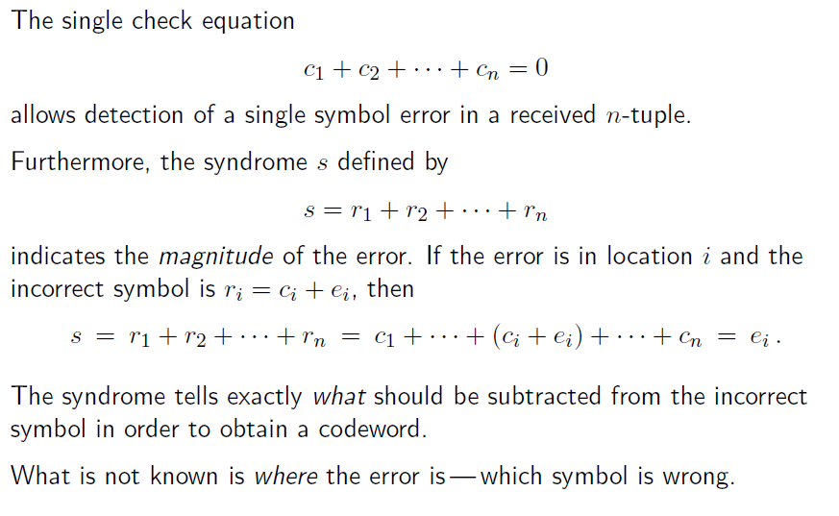
Nonbinary single error correcting code

Slide 39
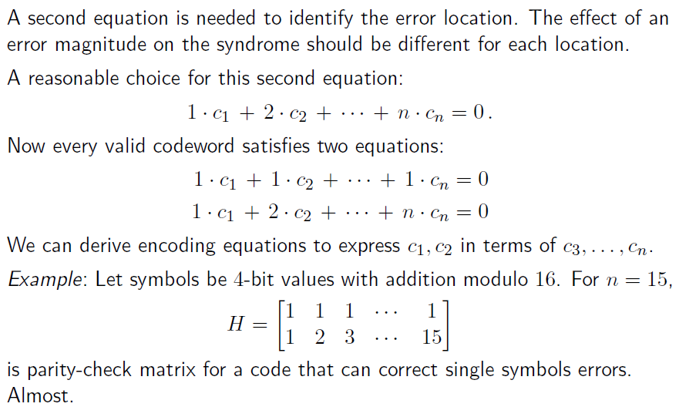
More equations needed

Slide 40
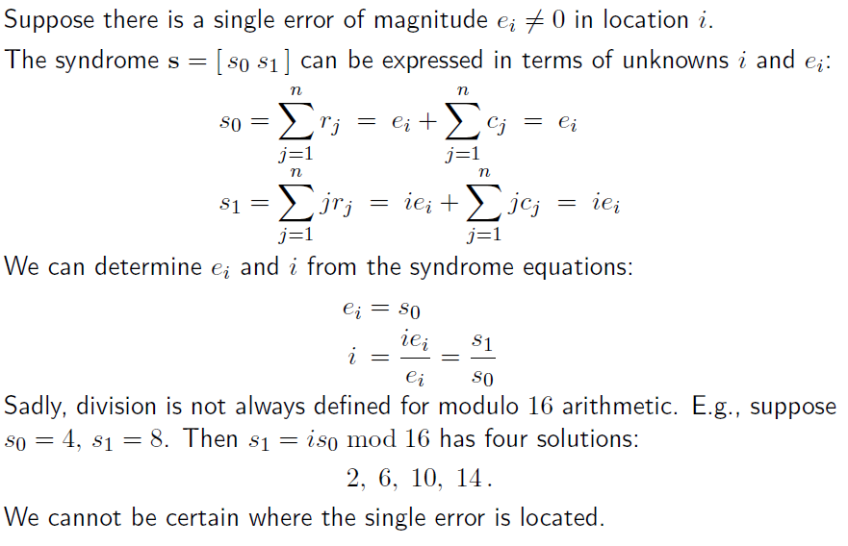
Decoding procedure

Slide 41
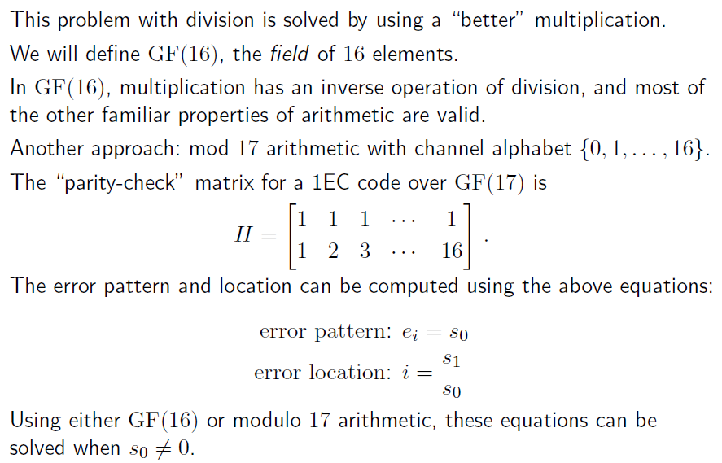
Finite Fields

Slide 42
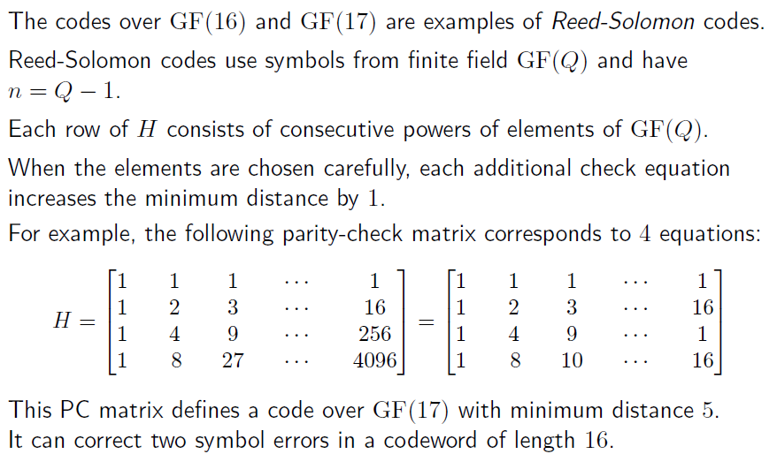
Reed-Solomon codes

Slide 43
Galois Field
Definition: Field: a complete group of elements with:
Addition, subtraction, multiplication, division
+ - * /
Completely closed under these operations
Every element has an additive inverse
a + b = 0
Every element except zero has a multiplicative inverse
a * b = 1

Slide 44
Galois Field Examples
Real numbers
Binary, called GF(2) ⇐ Galois Field with base 2
Values 0, 1. Addition/subtraction: use xor. Multiplicative inverse of 1 is 1
Prime field, GF(p) ⇐ Galois Field with base p
Values 0 … p-1
Addition/subtraction/multiplication: modulo p
Multiplicative Inverse: every value except 0 has inverse
Example: GF(5): 1×1 ≡ 1 mod 5, 2×3 ≡ 1mod 5, 4×4 ≡ 1 mod 5
General Galois Field: GF(p^{m}) ⇐ base p (prime!), dimension m
Values are vectors of elements of GF(p) of dimension m
Add/subtract: vector addition/subtraction
Multiply/divide: more complex
Just like real numbers but finite!
Common for computer algorithms: GF(2^{m})

Slide 45
Galois Field Examples GF(2^{n})
Consider polynomials whose coefficients come from GF(2).
Each term of the form x^{n} is either present or absent.
Examples: 0, 1, x, x², and x⁷ + x⁶ + 1
= 1·x⁷ + 1· x⁶ + 0 · x⁵ + 0 · x⁴ + 0 · x³ + 0 · x² + 0 · x¹ + 1· x⁰
With addition and multiplication these form a “ring” (not quite a field – still missing division):
“Add”: XOR each element individually with no carry:
x⁴ + x³ + + x + 1
+ x⁴ + + x² + x
x³ + x² + 1
“Multiply”: multiplying by x is like shifting to the left.
x² + x + 1
× x + 1
x² + x + 1
x³ + x² + x
x³ + 1

Slide 46
What about division (mod)
x⁴ + x²
= x³ + x with remainder 0
x
x⁴ + x² + 1
= x³ + x² with remainder 1
X + 1
x³
+ x²
+ 0x
+ 0
X + 1
x⁴ + 0x³ + x² + 0x + 1
x⁴ + x³
x³ + x²
x³ + x²
0x² + 0x
0x + 1
Remainder 1

Slide 47
Galois Fields
These polynomials form a Galois (finite) field if we take the results of this multiplication modulo a prime polynomial p(x)
A prime polynomial cannot be written as product of two non-trivial polynomials q(x)r(x)
For any degree, there exists at least one prime polynomial. With it we can form GF(2^{n})
Every Galois field has a primitive element, α, such that all non-zero elements of the field can be expressed as a power of α
Certain choices of p(x) make the simple polynomial x the primitive element. These polynomials are called primitive
For example, x⁴ + x + 1 is primitive. So α = x is a primitive element and successive powers of α will generate all non-zero elements of GF(16).
Example on next slide.

Slide 48
Galois Fields with primitive x⁴ + x + 1
α⁰ = 1
α¹ = x
α² = x²
α³ = x³
α⁴ = x + 1
α⁵ = x² + x
α⁶ = x³ + x²
α⁷ = x³ + x + 1
α⁸ = x² + 1
α⁹ = x³ + x
α¹⁰ = x² + x + 1
α¹¹ = x³ + x² + x
α¹² = x³ + x² + x + 1
α¹³ = x³ + x² + 1
α¹⁴ = x³ + 1
α¹⁵ = 1
Primitive element α = x in GF(2^{n})
In general finding primitive polynomials is difficult. Most people just look them up in a table, such as:
α⁴ = x⁴ mod x⁴ + x + 1
= x⁴ xor x⁴ + x + 1
= x + 1

Slide 49
Primitive Polynomials
x² + x +1
x³ + x +1
x⁴ + x +1
x⁵ + x² +1
x⁶ + x +1
x⁷ + x³ +1
x⁸ + x⁴ + x³ + x² +1
x⁹ + x⁴ +1
x¹⁰ + x³ +1
x¹¹ + x² +1
x¹² + x⁶ + x⁴ + x +1
x¹³ + x⁴ + x³ + x +1
x¹⁴ + x¹⁰ + x⁶ + x +1
x¹⁵ + x +1
x¹⁶ + x¹² + x³ + x +1
x¹⁷ + x³ + 1
x¹⁸ + x⁷ + 1
x¹⁹ + x⁵ + x² + x+ 1
x²⁰ + x³ + 1
x²¹ + x² + 1
x²² + x +1
x²³ + x⁵ +1
x²⁴ + x⁷ + x² + x +1
x²⁵ + x³ +1
x²⁶ + x⁶ + x² + x +1
x²⁷ + x⁵ + x² + x +1
x²⁸ + x³ + 1
x²⁹ + x +1
x³⁰ + x⁶ + x⁴ + x +1
x³¹ + x³ + 1
x³² + x⁷ + x⁶ + x² +1

Slide 50
Primitive Polynomials
Galois Field Hardware
Multiplication by x ⇔ shift left
Taking the result mod p(x) ⇔ XOR-ing with the coefficients of p(x)
when the most significant coefficient is 1.
Obtaining all 2^{n}-1 non-zero
elements by evaluating x^{k} ⇔ Shifting and XOR-ing 2^{n}-1 times.
for k = 1, …, 2^{n}-1

Slide 51
Reed Solomon Codes
Galois field codes: code words consist of symbols
Rather than bits
Reed-Solomon codes:
Based on polynomials in GF(2^{m}) (I.e. m-bit symbols)
Data as coefficients, code space as values of polynomial:
P(x)=a₀+a₁x¹+… a_{k-1}x^{k-1}
Coded: P(0),P(1),P(2)….,P(n-1)
Can recover polynomial as long as get any k of n

Slide 52
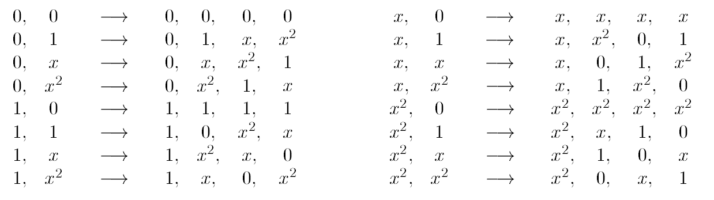
Example
Galois field GF(4)
Reed-Solomon Code with n=q=4, k=2
Full coding map:

Slide 53
The Singleton bound and MDS codes
The Singleton bound: fundamental bound on (n, k, d) over any field:
k + d <= n + 1
Proof: The code can correct any set of d-1 erasures.
Erasing the last d-1 symbols, the codewords are different.
Number of codewords <= q^{n-d+1}
MDS codes: A code that meets this bound with equality is called “maximum distance separable” (MDS).
Reed-Solomon Code is an MDS code

Slide 54
Decoding of Reed-Solomon Codes
Reed-Solomon codes can be decoded rather easily using finite-field arithmetic.
Decoding algorithms such as Peterson, Berlekamp-Massey, Euclid, and Welch-Berlekamp have been developed for error-correction and erasure-and-error correction.
Sudan and others have derived list and soft-decision error-correction algorithms that can decode significantly beyond the guaranteed error-correction capability
Polynomial-time, most efficient requiring the order of n² finite-field operations

Slide 55

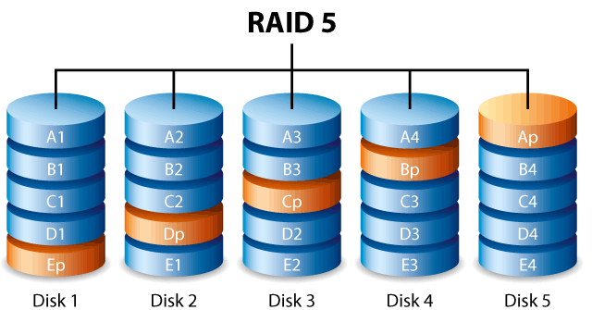
Applications of Erasure Coding
File transmission (code on file blocks)
Disk Failures (Redundant Array of Independent Disks)

Slide 56
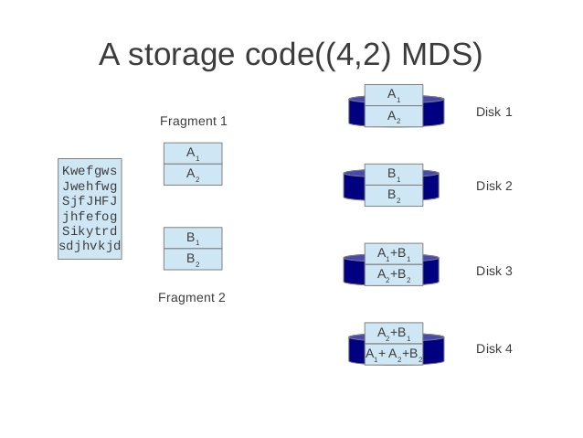
Applications of Erasure Coding
Distributed File System (Azure, Hadoop 3.0)
vs. 3 replications

Slide 57
Applications of Erasure Coding
Distributed File System (Azure, Hadoop 3.0)
vs. 3 replications

Slide 58
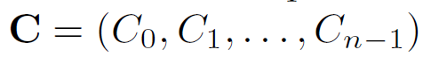
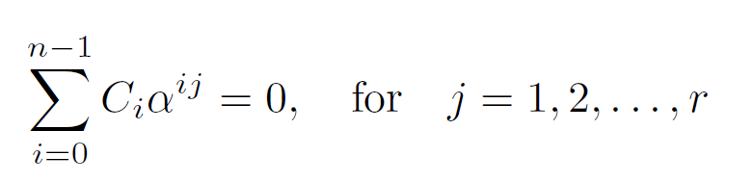
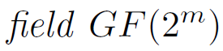
Reed-Solomon Code
Codewords satisfies

Slide 59
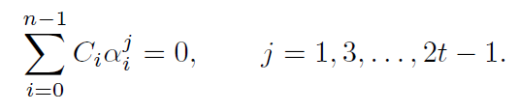
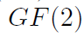
Bose–Chaudhuri–Hocquenghem (BCH）codes
Codewords satisfies
odd
Codewords are in field GF(2)
Orders are odd

Slide 60
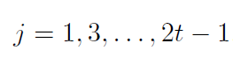

BCH codes
Why do we choose odd ?

Slide 61

BCH codes
m=8, n=255
Parity checks: 8*t
k = 255 – 8 *t

Slide 62


BCH codes Applications
Telecommunication
SSD

